Slide 1




“Status of IPSAS implementation in Latin American countries”
27, 28 y 29 de julio de 2016
Sheraton Asunción Hotel

Slide 2




Agenda
1
Introduction
2
Objectives of the study
3
Participating countries
4
Overall survey approach
5
Methodology of the gap analysis
6
Methodology of the interviews on IPSAS related benefits
7
Planned layout of the presentation of results
8
Timeline and status of the project
9
Next steps

Slide 3







Estrategia del BID para el Uso de Sistemas Nacionales
Mejor ejecución y supervisión de las operaciones
1
Ahorros por la reducción de costos de transacción
2016
2
3
Sinergias estratégicas y técnicas
2014
4
Eliminación de las duplicidades
2011
Alianza Global para la Cooperación Eficaz al Desarrollo
Alianza de Busan
2010
Estrategia BID – Uso de Sistemas Nacionales
1
Mayor conocimiento y gestión de la información
Agenda de Acción de Accra
2
Eficiencia, eficacia y transparencia en el uso de los recursos
2008
3
Fortalecimiento y reconocimiento de las capacidades
técnicas y estratégicas del país
4
Establecimiento de estándares de desempeño conforme a las mejores prácticas internacionales
Declaración de París
2005
5
Modernización de los sistemas de gestión y rendición de cuentas

Slide 4
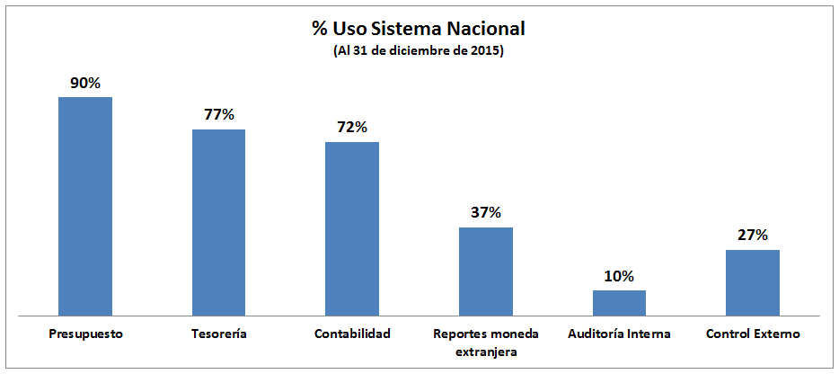
Reporte Uso de Sistemas Nacionales

Slide 5
Recursos BID apoyo a países miembro para fortalecer el Uso de Sistemas Nacionales
En los últimos 5 años el BID ha financiado recursos a los países miembros del BID por aproximadamente US$ 6 millones.
En los últimos 2 años aproximadamente USD 650 mil en materia de NICSP

Slide 6
Objectives of the study

Slide 7

  Determine the status of IPSAS adoption on central government level in selected Latin American and Caribbean countries.
1
  Explain the benefits of its implementation to policy makers and government officials who are not accountants or practitioners.
2

Slide 8
Participating Countries

Slide 9
  Brazil
  Chile
  Colombia
  Costa Rica
  Dominican Republic
  Ecuador
  El Salvador
  Guatemala
  Honduras
  Mexico
  Nicaragua
  Panamá
  Paraguay
  Peru
  Uruguay
  New Zealand
15 FOCAL member countries participate based on a voluntary decision.
New Zealand was chosen as a reference basis.

Slide 10
Overall survey approach

Slide 11
  Structured interviews on reform progress and level of IPSAS alignment to be held with the Accountant General / Ministry of Finance (gap-analysis)
1
  Semi-structured interviews on IPSAS related benefits to be held with selected national key stakeholders and international development aid organizations
2

Slide 12
Methodology of the gap analysis

Slide 13
Gap analysis
A gap analysis aims to express the proximity of the national accounting framework with the accrual basis IPSAS in percentage terms.
This approach allows comparing the national accounting practices at an international level.
General questions on the maturity of the current national accounting practices are added to better understand country specifics (not included in the assessment of the alignment level).
The gap analysis is performed for the following standards:
  Presentation and Disclosure
    IPSAS 01 Presentation of Financial Statements
    IPSAS 02 Cash Flow Statements
    IPSAS 03 Accounting Policies, Changes in Estimates and Errors
    IPSAS 18 Segment Reporting
    IPSAS 24 Presentation of Budget Information in Financial Statements
  Major Assets: Recognition and Measurement
    IPSAS 11 Construction Contracts
    IPSAS 17 Property, Plant and Equipment
    IPSAS 21 Impairment of Non-Cash Generating Assets
    IPSAS 32 Service Concession Arrangements: Grantor
  Major Liabilities: Recognition and Measurement
    IPSAS 19 Provisions, Contingent Liabilities and Contingent Assets
    IPSAS 25 Employee Benefits
    IPSAS 29 Financial Instruments: Recognition and Measurement
  Revenue
    IPSAS 23 Revenue from Non-Exchange Transactions (Taxes and Transfers)
  Consolidation
    IPSAS 06 Consolidated and Separate Financial Statements
    IPSAS 07 Investments in Associates
    IPSAS 08 Joint Ventures

Slide 14
Calculation of the level of alignment per IPSAS
Three answer categories are provided for the analysis of the proximity to IPSAS. The underlying assumption to calculate the level of alignment is as follows:
In a first step all questions are weighted equally. In a second step, to avoid a pre-dominance of questions related to disclosures, the IPSASs are clustered into sub-categories. The level of alignment is the average of those predefined categories.
  “Different” = 0% “Similar” = 50% “Identical” = 100%
Example for a level of alignment of 75% to IPSAS 19

Slide 15
Calculation of the overall level of alignment
A weighting factor in a range from 1 to 5 is applied to the degree of alignment per individual standard when calculating the overall alignment level.
This weighting factor reflects the relative importance of the standard compared to others in terms of reporting, the significance of the balance sheet position concerned and the fact if the standard is applicable to all or only a limited number of public sector entities.
Selected accounting areas | Factor |  | Selected accounting areas | Factor
IPSAS 1 | 5 |  | IPSAS 32 | 4
IPSAS 2 | 4 |  | IPSAS 19 | 4
IPSAS 3 | 2 |  | IPSAS 25 | 5
IPSAS 18 | 1 |  | IPSAS 29 | 3
IPSAS 24 | 3 |  | IPSAS 23 | 5
IPSAS 11 | 1 |  | IPSAS 6 | 4
IPSAS 17 | 5 |  | IPSAS 7 | 2
IPSAS 21 | 3 |  | IPSAS 8 | 3

Slide 16
Example: calculation of the overall level of alignment

Slide 17
Methodology of the interviews on IPSAS related benefits

Slide 18
Methodology of the interviews on IPSAS related benefits
Semi-structured interviews with development aid agencies and national stakeholders regarding IPSAS related benefits on donor projects and economic development.
  Designing the questionnaire, we first developed basic assumptions, which cover certain theoretical benefits related to IPSAS. With the help of the questionnaire these assumptions will either be confirmed or rejected.
  There is space offered for additional benefits not yet covered by our assumptions.
  On the one hand this approach ensures that all aspects are considered that we assume being important. On the other hand it provides a structure which facilitates the analysis of the interviews and to derive statements and conclusions.
  The interview partner will also be asked to make a ranking of the assumptions according to his / her personal perception of the importance and feasibility of the described benefits.

Slide 19
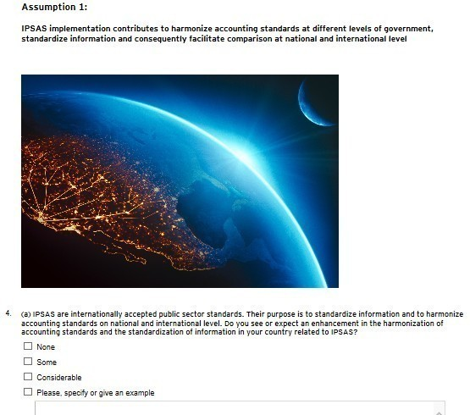
Online questionnaire
(Extract 1)

Slide 20
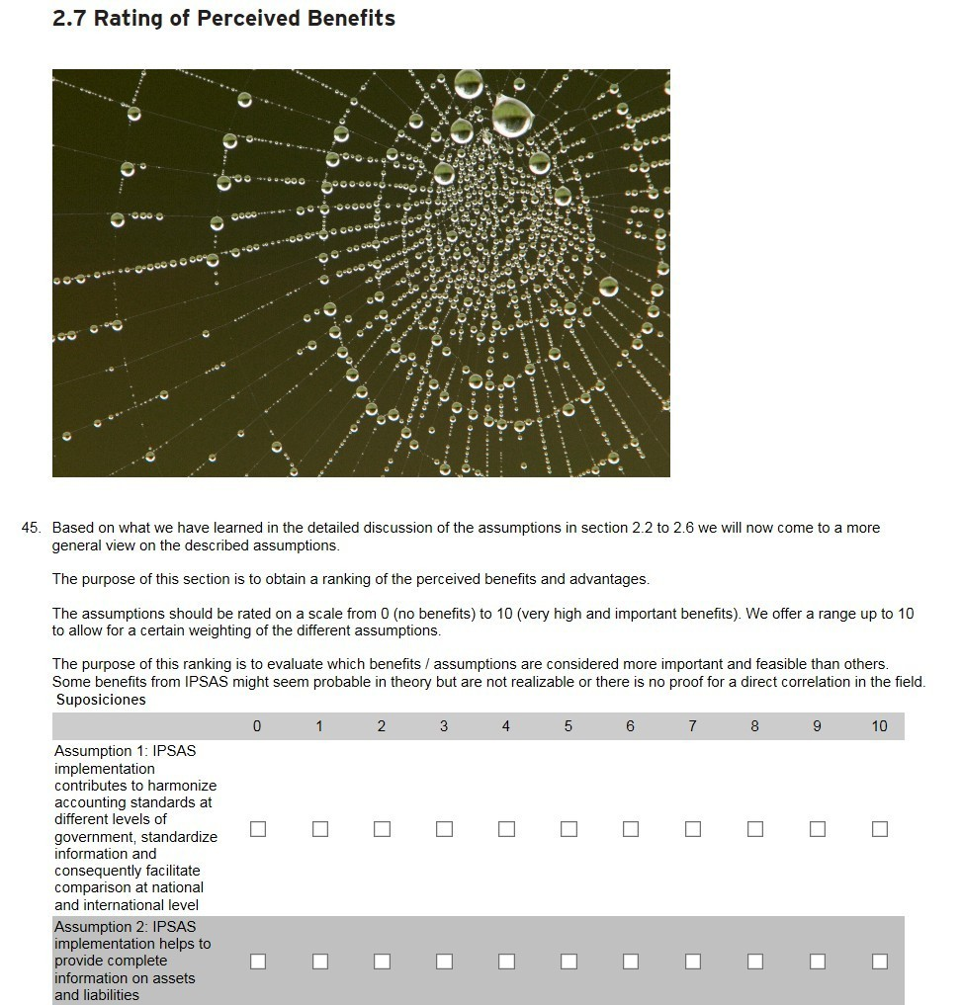
Online questionnaire
(Extract 2)

Slide 21
Planned layout of the presentation of results

Slide 22
Presentation of results in the individual country reports:
This illustration visualizes the source of the identified gaps.
For example: If the adoption of disclosures is scheduled at a later stage of a reform process and currently the government focusses on recognition and measurement of provisions, this will be reflected in the chart and included in the comments on the table.

Slide 23
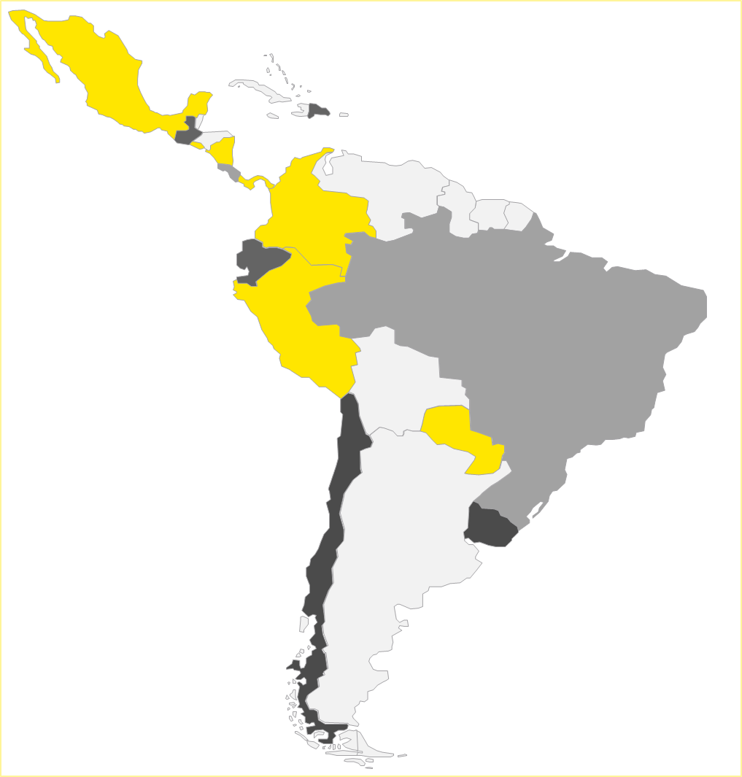
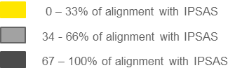
Presentation of the overall level of alignment with IPSAS:
X % - Y % of alignment with IPSAS
X % - Y % of alignment with IPSAS
X % - Y % of alignment with IPSAS
Any main country specific circumstances with a major influence on the implementation of IPSAS will be described in the country report (attachment) and will also be reflected in the analysis of the overall results (main report).
We plan to comment on the main source of gaps between national and international standards - especially on the fact whether those gaps are temporary (transitional provisions).

Slide 24
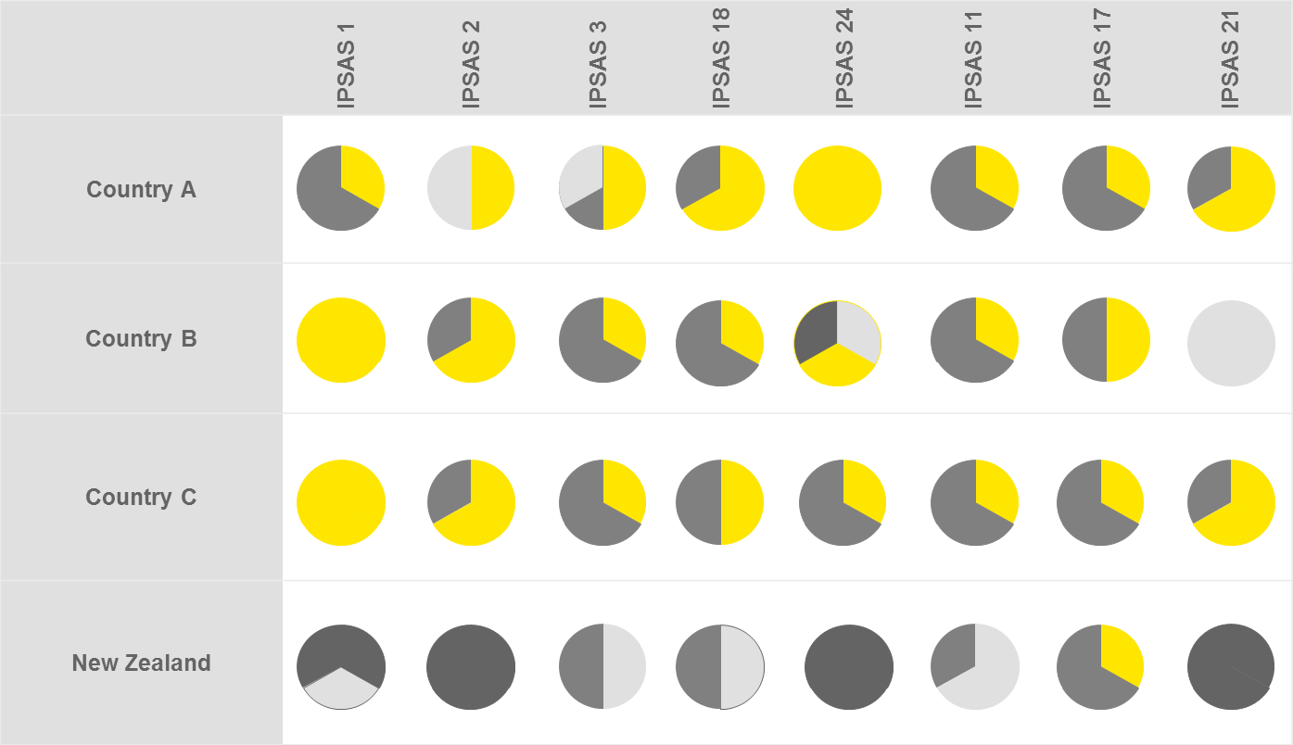
Presentation of the alignment per IPSAS and comparison amongst countries
(The images are not based on actual results)

Slide 25
Timeline and status of the project

Slide 26
Project Timeline
Preparation of the survey
Preparation of the survey
Coordination and status reports
Core Team
Quality check
of local survey results
Analysis of results and draft overall report
Local Teams
Interview, draft
country report
Validation by government
Phase 1
Phase 2 (2 months)
Phase 3 (2 months)
Deliver
June 1
July 31
September 30
Kick-off Calls with local teams
Delivery of country report and survey results
Delivery of the draft overall report

Slide 27
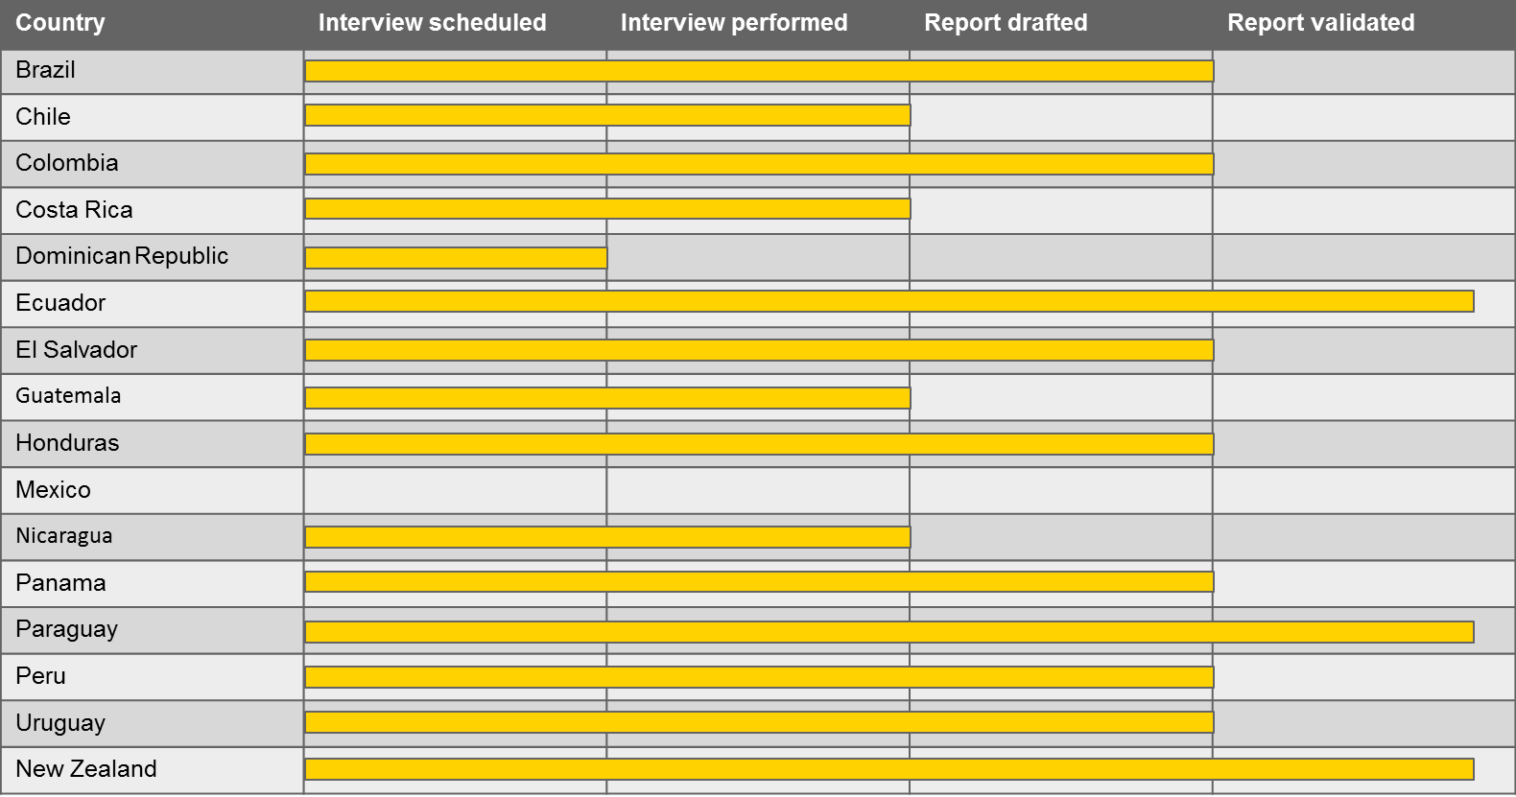
Current status of the country reports as of July 15

Slide 28
Next steps

Slide 29

Translation of the validated country reports
  Consolidation, comparison and analysis
  Draft of the overall report
  Analysis of the interviews on benefits
  Draft of papers on IPSAS related benefits
Delivery of the draft report to IDB on 30 September 2016.

Slide 30

Thank you!

