Slide 1

Organization and Accounting for PPPs and Concession Contracts.
Prof. Frans van Schaik

Slide 2
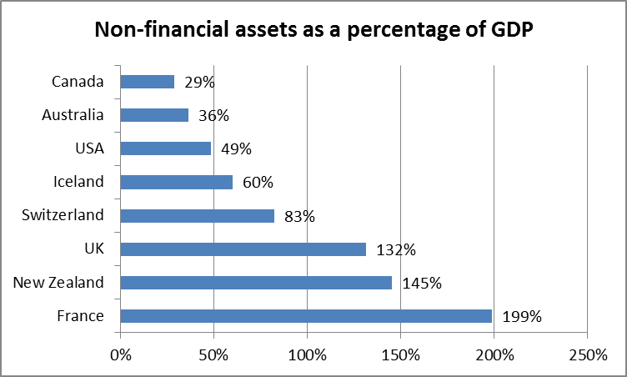
Non-financial assets have huge impact on government balance sheet

Slide 3
Basic drives of man are few: to get enough food, to find shelter, and to keep debt off the balance sheet.
Greene (The joys of leasing, 1989)

Slide 4
Public-private partnerships: an important accounting issue for governments
Accrual accounting:
Should the fixed asset and the liability be on the government’s statement of financial position?
Off-balance sheet accounting is dangerous:
  Government liabilities are understated
  Payment burdens are shifted onto future generations - without transparency
  Cash accounting:
  Governments looking for ways to reduce deficit and public debt.

Slide 5
Public-Private Partnerships: 50 shades of grey

Slide 6
Definitions
A grantor (government) is the entity that grants the right to use the service concession asset to the operator.
An operator (company) is the entity that uses the service concession asset to provide public services subject to the grantor’s control of the asset.
A service concession arrangement is a binding arrangement between a grantor and an operator in which:
  The operator uses the service concession asset to provide a public service on behalf of the grantor for a specified period of time; and
  The operator is compensated for its services over the period of the service concession arrangement.

Slide 7
Scope of IPSAS 32 Service Concession Arrangements - Grantor
Arrangements within scope:
  Operator providing public services related to the service concession asset on behalf of the grantor.
Arrangements outside scope:
  No delivery of public services
  Examples: outsourcing, service contracts, privatization.

Slide 8
Service concession asset - definition
An asset used to provide public services in a service concession arrangement that is an:
existing asset of the operator
asset constructed or developed by the operator
asset acquired by the operator
existing asset of the grantor
upgrade to an existing asset of the grantor

Slide 9
Grantor recognizes a service concession asset if:
The grantor controls or regulates what services the operator must provide with the asset, to whom it must provide them, and at what price; and
The grantor controls—through ownership, beneficial entitlement or otherwise—any significant residual interest in the asset at the end of the term of the arrangement.
For a “whole-of-life” asset, only the conditions in paragraph (a) need to be met.
“Mirror image” to IFRIC 12

Slide 10
Liability: two models
Financial Liability Model:
  The grantor compensates the operator by making a predetermined series of payments to the operator.
  The grantor recognizes a financial liability, which is a financial instrument (IPSAS 28, 29, 30).
Grant of a Right to the Operator Model:
  The grantor compensates the operator by granting the operator the right to earn revenue from third-party users.
  The grantor recognizes a liability for any portion of the revenue that is not yet earned.

Slide 11
Revenue recognition:
Financial Liability Model
Payments to the operator are allocated and accounted for according to their substance as:
  a reduction in the liability
  a finance charge
  charges for services provided by the operator.
If the asset and service components of a service concession arrangement are separately identifiable,
the amount allocated to each component is determined by reference to their relative fair values.
If the components are not separately identifiable, the components are determined using estimation techniques.
The finance charge and charges for services provided by the operator are accounted for as expenses.

Slide 12
Revenue recognition:
Grant of a Right to the Operator Model
Grantor does not recognize revenue immediately because the right granted to the operator is effective for the period of the service concession arrangement.
Grantor earns the benefit associated with the assets received in the service concession arrangement in exchange for the right granted to the operator over the period of the arrangement.
A liability is recognized for any portion of the revenue that is not yet earned.
Revenue related to the recognition of the service concession asset is recognized according to the economic substance of the service concession arrangement, and the liability is reduced as revenue is recognized.

Slide 13
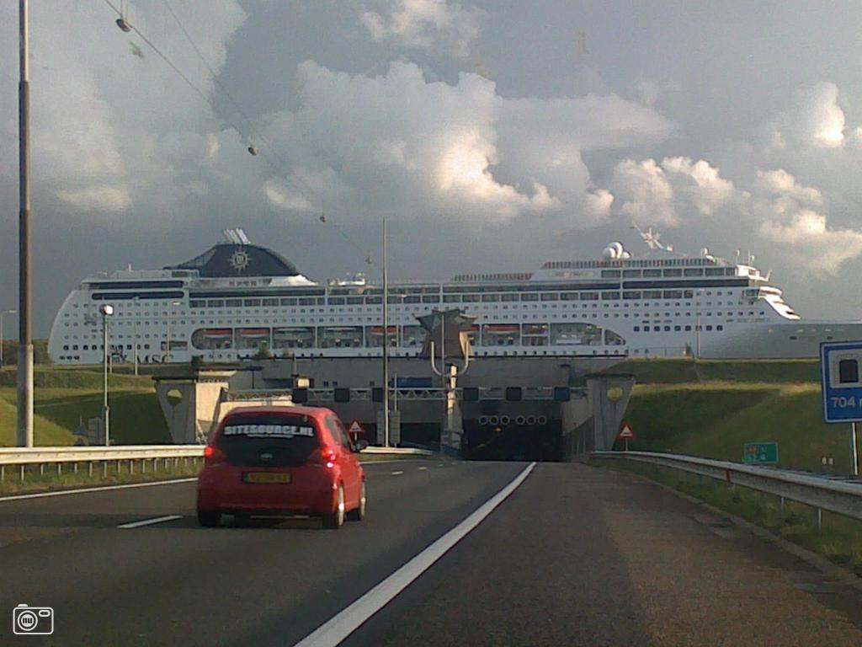
Wijkertunnel

Slide 14
Wijkertunnel: reporting in accordance with IPSAS 32
First large service concession arrangement in the Netherlands
Tunnel under canal between Amsterdam and North Sea
Consortium of banks (among others ING and Commerzbank) paid 3/4 of 272 million euro building costs
Shadow toll: Netherlands government pays toll to the consortium for each vehicle passing through the tunnel during 30 years. Present value of expected payments: 1 billion euro.

Slide 15
Wijkertunnel – Is this a service concession arrangement?
Yes:
  The operator uses Wijkertunnel to provide a public service on behalf of the grantor for a specified period of time; and
  The operator is compensated for its services over the period of the service concession arrangement.
Wijkertunnel is an asset constructed by the operator

Slide 16
Does Wijkertunnel meet the recognition criteria of a service concession asset for the grantor?
Yes. Meets both recognition criteria:
The grantor controls or regulates what services the operator must provide with the asset, to whom it must provide them, and at what price.
The grantor controls—through ownership, beneficial entitlement or otherwise—any significant residual interest in the asset at the end of the term of the arrangement.
Government controls price (free)

Slide 17
Wijkertunnel: Financial liability model or
Grant of a right to the operator model?
Financial liability model, because:
  The grantor compensates the operator by making a predetermined series of payments to the operator.
Accounting:
  The grantor recognizes a financial liability, i.e. a financial instrument (IPSAS 28, 29, 30).
  Determinable series of payments (IPSAS 32, BC4, BC25)

Slide 18
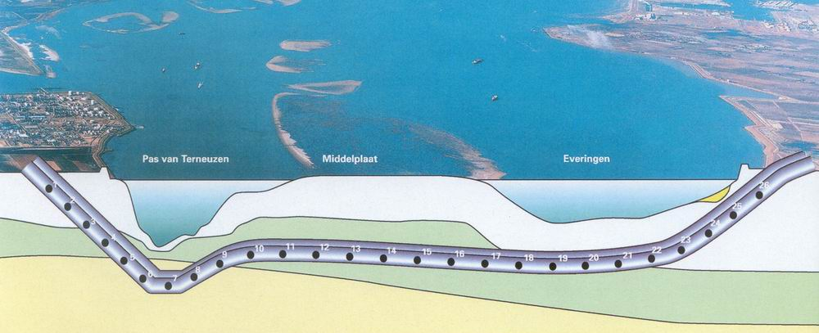
Westerscheldetunnel Ltd.

Slide 19
Westerscheldetunnel Ltd.: reporting in accordance with IPSAS 32
Building costs: € 725 million
Public corporation - objective: design, build and operate a 6.6 km tunnel under the Westerschelde river
All shares owned by government
Tol: rate varies between € 3,50 and € 22,50 per vehicle (approximately 40% of all costs)
After 30 years capital expenditure will have been recovered and tunnel will be free

Slide 20
Westerscheldetunnel – Is this a service concession arrangement?
Yes:
  The operator uses Westerscheldetunnel to provide a public service on behalf of the grantor for a specified period of time; and
  The operator is compensated for its services over the period of the service concession arrangement.
Westerscheldetunnel is an asset constructed by the operator (N.V.)

Slide 21
Should government recognize Westerscheldetunnel as an asset?
Yes. Tunnel meets both recognition criteria:
The grantor controls or regulates what services the operator must provide with the asset, to whom it must provide them, and at what price.
The grantor controls—through ownership, beneficial entitlement or otherwise—any significant residual interest in the asset at the end of the term of the arrangement.
Government controls price by regulation
Government controls residual value (after 30 years), even though N.V. retains ownership

Slide 22
Westerscheldetunnel: Financial liability model or Grant of a right to the operator model?
Grant of a Right to the Operator Model, because:
  The grantor compensates the operator by granting the operator the right to earn revenue from third-party users.
Accounting:
  The government recognizes a liability for any portion of the revenue that is not yet earned.
  Revenue related to the recognition of the service concession asset is recognized according to the economic substance, and the liability is reduced as revenue is recognized

Slide 23
PPP arrangements outside scope of IPSAS 32:
IPSAS 13 Leases may apply
Government as a lessee, if:
the public sector grantor controls or regulates the services the operator provides,
but the residual interest in the fixed asset goes to the private sector operator
Government as a lessor, if:
the public sector grantor does not control or regulate the services the operator provides,
but the residual interest in the fixed asset goes to the grantor

Slide 24
If government does not control price:
Accounting as a lease (IPSAS 13)
Meets lease criteria: lessor (government) conveys to lessee in return for payment the right to use an asset for an agreed period of time
Finance lease: it transfers to the operator substantially all risks and rewards.

Slide 25
Public-Private Partnership other than concession contracts
PPP arrangements outside the scope of IPSAS 32 include those where there is no delivery of public services, and where the asset is not controlled by the government, e.g. outsourcing and service contracts
Building of the Ministry of Finance of the Netherlands:
  DBOM (Design-Build-Operate-Maintain) arrangement
  The private sector entity bears the risks of constructing the building, along with the risks of its operation and maintenance
  No delivery of public services

Slide 26
Consistence with other standards
Consistent with IFRIC 12, the IFRS interpretation applicable to private sector operators (mirror image)
Inconsistent with statistical bases which focuses on risk and rewards rather than control.
Government is not required to record liability when operator assumes:
  construction risk and
  either supply risk (availability) or demand risk

Slide 27
Lessons learnt
IPSAS 32 is major improvement of government financial reporting in:
  Accountability, because service concession assets and liabilities are no longer off-balance sheet
  Decision-making, because service concession arrangements should now be justified by value-for-money rather than meeting debt reduction objectives
There is a need for supreme audit institutions to scrutinize complex service concession arrangements, because governments have a preference for off-balance sheet accounting

Slide 28
IPSAS. For better decision making and accountability in government.
Visit www.ipsasb.org
or mail schaikf@euronet.nl
fvanschaik@uva.nl

