Slide 1
European developments in public sector accounting – Lessons learned
  Thomas Müller-Marqués Berger
  18 November 2014
Notes:
Financial instability in different countries has become one of the main causes for global economic crisis. IFAC is promoting the need for enhanced public sector reporting and financial management through its recently launched Accountability Now! initiative, which aims to promote awareness, facilitate guidance on implementation of IPSASs, and encourage the development of needed technical skills. The improvement of accountability practices in the public sector is not only
a necessary solution for global economic and financial governance, but also an essential tool to increase the level of democracy and to enable greater transparency on the use of public resources. The session aims to present different perspectives and to fuel the debate on the state-of-the-art and future development in these topics.

Slide 2
Agenda
1. The sovereign debt crisis: causes and lessons learned
2. Role of the public sector for the performance of the private sector
3. Public sector accounting reforms: impact of the political system
Sovereign debt crisis
Role of public sector
Impact of political system

Slide 3
The sovereign debt crisis: causes and lessons learned

Slide 4
The sovereign debt crisis: causes and lessons learned
Background and causes
Macroeconomic factors:
  Weak actual and potential growth in the EU
  Competitive weaknesses (e.g. wages and pension commitments in Greece) and weaknesses in the governance of banks (e.g. Spain)
  Large debt-to-GDP-ratios
  Downgrading of PIGS-states by rating agencies
  European banks own a significant amount of sovereign debt
Entity-level factors:
  Considerable liability stock (government, private, and non-private sector)
  Non-harmonized micro-level public-sector accounting data (public sector accounting varies even within EU countries!)
  Limitations of cash-based information
  Greek government revised deficit forecasts several times
European Union currently is a currency union and not a fiscal union!
Sovereign debt crisis
Role of public sector
Impact of political system
Notes:
Weak actual and potential growth in the EU: only a real GDP growth rate of 0,4 % in 2008 for EU-27 countries; low rates in
Competitive and banking weaknesses
Private debt arising from a property bubble were transferred to sovereign debt as a result of banking system bailouts (Spain)
High public sector wage and pension commitments (Greece)
Securitization of future government revenues to reduce debts and/or deficits
=> allowed sovereigns to mask their deficit and debt levels (by accounting; off-balance-sheet transactions, use of complex currency and credit structures)
Limitations of cash-based information => ESA is principally on accruals; but the problem is that cash info goes into those data => garbage in, garbage out
fiscal union = union with a common fiscal policy (taxation, spending etc.)

Slide 5
The sovereign debt crisis: causes and lessons learned
Lessons learned
  Problems:
    Lack of comparability of Member States‘ accounting
    Incoherence between government accounting and finance statistics
  European Commission has recognized that:
    Fiscal transparency is necessary for macroeconomic stability, surveillance and policy
    Harmonization of public sector accounting at micro level leads to better fiscal data (GFS) at macro level
  Current public sector accounting of some Member States is identified as significant weakness
  Solution: Development of harmonized accrual-based accounting/ financial reporting system for the public sector in Europe.
Sovereign debt crisis
Role of public sector
Impact of political system

Slide 6
The sovereign debt crisis: causes and lessons learned
Plans for an European accounting reform (1)
Main findings of the European Commission’s Report on the suitability of IPSAS (2013)
  Report recommends a single set of harmonized accruals-based accounting standards at all levels of government throughout the EU
  IPSASs in their current status cannot be simply implemented in EU Member States
  However, IPSASs represent an indisputable reference framework for potential EU harmonized accruals-based public sector accounts (so-called European Public Sector Accounting Standards, „EPSAS“)
  PwC study (2014): „most governments are relatively positive about using IPSAS as a primary reference for developing EPSAS”.
Sovereign debt crisis
Role of public sector
Impact of political system

Slide 7
The sovereign debt crisis: causes and lessons learned
Plans for an European accounting reform (2)
How Europe wants to achieve reliable and timely financial information for sound government policies:
  European Commission intends to set-up strong governance structure for the development of EPSAS
  Development of a “Conceptual Framework light”
  Discussions around standards (EPSAS) vs. principles (EPSAP)
  “EPSAS light” for smaller and less risky entities
  Reform focus solely on accounting/financial reporting
Sovereign debt crisis
Role of public sector
Impact of political system
Notes:
Current discussion points:
Scope and bindingness of EPSAS
Standards (EPSAS) vs. principles (EPSAP)
Basis for harmonization
IPSAS vs national standards vs GFS
Conceptual Framework
Reform focus is solely on accounting/financial reporting and not on budgeting

Slide 8
The sovereign debt crisis: causes and lessons learned
Plans for an European accounting reform (3)
Advantages and benefits of the proposed plans:
  Accruals as sound basis for GFS purposes
  Accrual accounts by government entities are audited
  => reliable basis for decision-making
  Complete overview on assets and (contingent) liabilities
    Accrual information shows service potential embodied in public infrastructure
    Depreciation/impairment shows use of assets
  Improvement of and focus on “business-relevant” processes
  Provides a complete financial overview of an entity through consolidated financial statements
  Better decision-making in terms of spending policies as well as taxation policies => Austrian example
Sovereign debt crisis
Role of public sector
Impact of political system

Slide 9
The sovereign debt crisis: causes and lessons learned
Austrian experiences with implementing IPSAS
Spending policies
  Focus is on organizational and operative decisions (e.g. “make-or-buy” decisions based on full cost)
  Discussion of the life cycle cost of infrastructure (e.g. Eurofighter)
  Risk management, e.g. provisions for the costs of litigation
  Overview of all obligations (e.g. obligation to preserve tunnel system from 2nd World War) => contract management
  Better management of transfers (e.g. investment grant)
Taxation policies
  Accrual information as a basis for planning future tax revenues
  Better management of tax revenues (e.g. matching of planned tax revenues against actual tax revenues => efficiency in tax collection)
Sovereign debt crisis
Role of public sector
Impact of political system
Notes:
Discussion of the life cycle cost of infrastructure, including depreciation (instead of focus solely on yearly investment rates)
-> e.g. Austria acquired Eurofighter => due to the high operation costs they are only used 100 hours per year (!)
Austria is legal successor of the Federal Republic of Germany => legal obligation to preserve tunnel system => provision

Slide 10
The sovereign debt crisis: causes and lessons learned
Accrual budgeting
  Lack of adequate information for decision-making in the context of budget planning as main driver for accrual budgeting
Embedding the accruals principle in budgeting contributes to better public management and decision-making
  Budgeting decisions and political execution decisions are made against the background of the potential accounting impact
  Debt and contract management
    Financing aspects especially relevant for long-term investments in infrastructure
  Less complexity if budgets and accounts are fully aligned
  Improved risk management
  Can be implemented after accrual accounting reform (phased implementation)
Sovereign debt crisis
Role of public sector
Impact of political system

Slide 11
Role of the public sector for the performance of the private sector

Slide 12
Role of the public sector for the performance of the private sector
Relationship between government financing and economic growth
  Government‘s access to global capital markets and financing conditions
  Determines the scope of action
  Investments by governments in infrastructure etc.
  Economic growth in private sector
Sovereign debt crisis
Role of public sector
Impact of political system

Slide 13
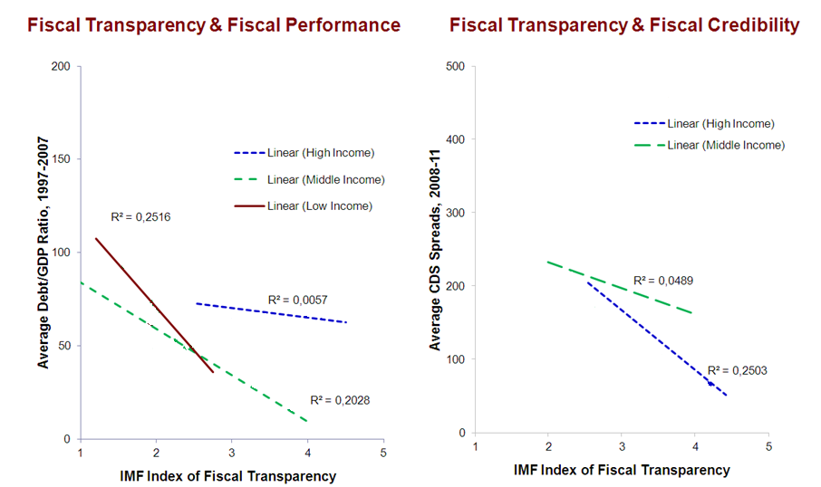
Role of the public sector for the performance of the private sector
The importance of fiscal transparency for governments’ financing conditions at capital markets
Source: INTERNATIONAL MONETARY FUND paper: “Fiscal Transparency, Accountability, and Risk”, Prepared by the Fiscal Affairs Department in collaboration with the Statistics Department
August 7, 2012
“The degree of fiscal transparency has been shown to be an important predictor of a country’s fiscal credibility and performance.”
Sovereign debt crisis
Role of public sector
Impact of political system

Slide 14
Role of the public sector for the performance of the private sector Effects of the sovereign debt crisis on the private sector?
% Eurozone: Unemployment rates
% Eurozone: Government spending growth year-on-year
Sovereign debt crisis
Role of public sector
Impact of political system

Slide 15
Role of the public sector for the performance of the private sector
Relationship between fiscal transparency and economic growth
  Fiscal transparency
  Government‘s access to global capital markets and financing conditions
  Investments by governments in infrastructure etc.
  Economic growth in private sector
It is not about accounting - it is about improving people’s lives by holding governments to account to deliver on their obligations without hiding the facts about who will pay for them.
Sovereign debt crisis
Role of public sector
Impact of political system

Slide 16
Public sector accounting reforms: impact of the political system

Slide 17
Public sector accounting reforms: impact of the political system
Public sector accounting in Germany vs. France
 | Germany | France
Public sector accounting landscape | Heterogeneous Federal: cash-basis State: mainly cash Local: mainly accrual | Homogeneous All government entities in France apply accrual accounting Consistent accounting policies for all French public administrations
Standard setting framework | Complex structure One standard setter at federal/state level but additional laws; ministries of interior of each state in charge of local governments | Simple structure One standard setter for all levels of government (CNoCP: Conseil de normalisation des comptes publics)
IPSAS compliance according to EY study | Clearly below average | Clearly above average
Sovereign debt crisis
Role of public sector
Impact of political system
Notes:
Using Germany (as federal system) and France (centralized system) as examples

Slide 18
Public sector accounting reforms: impact of the political system
Lessons learned
Politicians need to make more use of the information provided by accrual data
For successful accounting reforms political support is required
Different legal backgrounds (common (case) law vs. civil law) influences the standard setting approach
The standard-setter needs to have sufficient power
Principles/standards need to be binding
Public sector accounting standards does not need to differ between levels of governments
Sovereign debt crisis
Role of public sector
Impact of political system
Notes:
sufficient power => no “lame duck”

